Slide 1
Garage Door Monitor
Yes, the door is really Closed

Slide 2
Why do I need a Garage Door Monitor?
We forget to close the door… again
I like gadgets and data
I wanted to have a record of when the door opened and closed

Slide 3
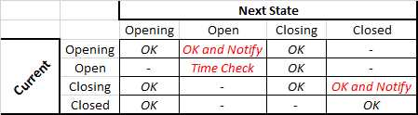
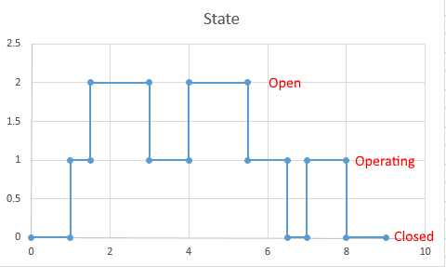
Garage Door Monitor Logic
State Diagram
Helpful to understand what you need to code
States used in code:
Opened - 1
Closed - 3
Auto-Closed - 4
Reboot – 9
Error – 8
Only for an invalid doorstatus
Operating - 2

Slide 4
Version 1.0

Slide 5

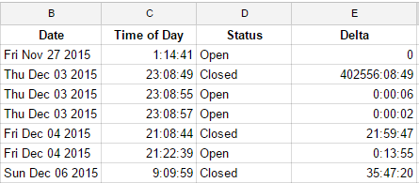
Components
Door Operate Relay
Other I/O
Google Sheet
Google Script
NODEMCU
ESP826612E
Door Open Sensor
Open, Closed, Operating
Calculate time since last state change
Door Closed Sensor

Slide 6



Code and Connections
GarageDoorMonitor.ino
GDM (Device)
GDM (Endpoint)
GarageDoorMonitor.gs
GarageDoorRecord (sheet)
Device ID
HTTPS address of Google Script
HTTPS address of Google Sheet (SPID)

Slide 7
Tasks
Create the Google Sheet
Header names and Sheet name are important
Publish and note the URL
Create the Google Script
Add the Sheet ID into the script
Run Setup once to add the SPID as a Key
Use ARC (Advanced Rest Client) Chrome extension for testing (Note not all JSON seems to get passed to the Script)
Using Thinger.io
Define the Device
NODEMCU software will need the ID
Create the HTTP Endpoint
Thinger.io will need to know Device and Google Script URL
Create the Code for the NODEMCU in the Arduino IDE

Slide 8
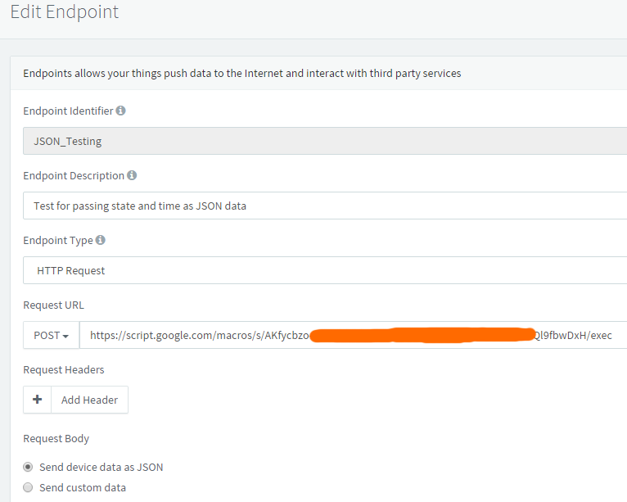
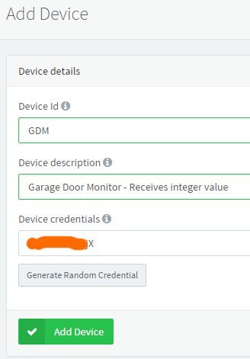
Thinger.io Device and HTTP Endpoint
Device: GDM
Connects NodeMCU to Thinger.IO
Endpoint: GDM_JSON
Endpoint is the connection between the Thinger.IO and Google Script

Slide 9
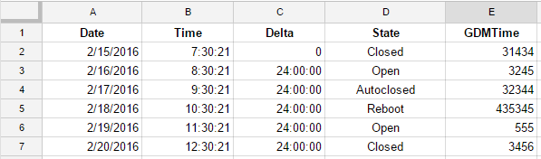
Google Sheets
Can be programmed from Google Script
Viewable from any device
Allows data capture and analysis
Free
Create a sheet
Column headers will be used to capture data from IoT device
- State & GDMTime
Note the ID from the URL

Slide 10
Google Script Logic
Google script is responding to an HTTPS request that is to run this script and process the enclosed JSON payload
Open and lock the Google Sheet
Functions for POST or GET response
handleResponse
Compares the headers in the Sheet to the JSON value keys and populates the spreadsheet with the values
Other header values are entered as functions or calculated values
Sheet is unlocked and closed
Test with ARC to see response.

Slide 11
Google Script
Javascript – lots of help available
Use ARC (Advanced Rest Client) plugin for Chrome to test Javascript decode of JSON payload (simulate data from IoT broker)
Example: {"state":2,"GDMtime":"858881"} is the ‘payload’ sent through the system from the ESP8266 through Thinger.io to the Google Script.
Google Script is very sensitive to processing the JSON data
Hard to debug
See script for a process that worked with Thinger.IO HTTP Endpoint

Slide 12
Version 2.0

Slide 13
Why Version 2?
ESP8266 https does not redirect or seem to work with google script
Thinger.io HTTP endpoint can work great, but is hard to repeat a setup
My initial setup works very reliably, but was tough setup and I could not duplicate
Ran for 3 months with no failure or reboot.
Google script calls from HTTPS are hard to validate and debug.
Since I could not repeat the setup I was using, I decided to pursue a variation
Maker Endpoint with IFTTT
New Requirements
Create a stable and repeatable system.
Capture the Status and time parameter with IFTTT to sheet
Send a message if door auto-closes or reboots.
Set the stage for updating the module for remote open/close and permitted open time value.

Slide 14



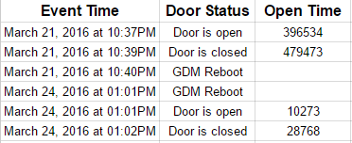
Components V2
Door Operate Relay
Door Open Sensor
Google Sheet
NODEMCU
ESP826612E
Door Closed Sensor

Slide 15

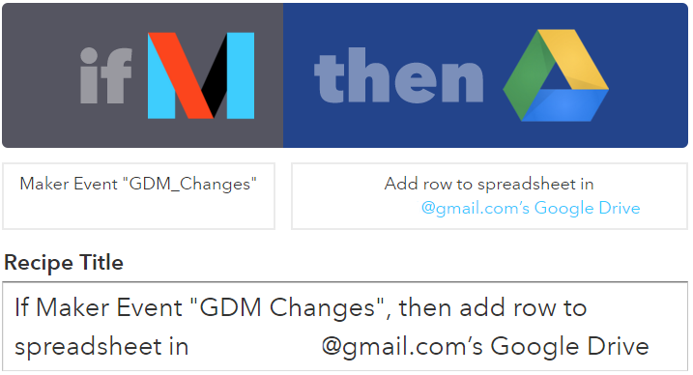
Code and Connections V2
GarageDoorMonitor2.ino
GDM2 (Device)
GDM2 (Endpoint)
GarageDoorRecord (sheet)
Device ID

Slide 16
Tasks V2
Using Thinger.io - https://thinger.io/
Define the Device
NODEMCU software will need the ID
Create the IFTTT Maker Channel Trigger Endpoint
This can then do several things
Add information to the Spreadsheet
Send a message if it reboots or auto-closed the door.
Create the Code for the NODEMCU in the Arduino IDE
Create a GIT repository for the project
https://github.com/Peterh226/GarageDoorMonitor
Publish Project on Instructables

Slide 17
IoT Device
NODEMCU (~$8 Amazon, ~$6.50 Banggood)
Built-in USB simplifies everything
Reset, Program switches
Built-in LED (used for a heartbeat monitor)
Inexpensive and easy to use
Programming
Used Arduino IDE
https://github.com/esp8266/Arduino
Used various other utilities to flash and play around with NODEMCU
NODEMCU Flasher - http://www.nodemcu.com
LuaLoader - http://benlo.com/esp8266/index.html#LuaLoader
ESPlorer - http://esp8266.ru/esplorer/

Slide 18
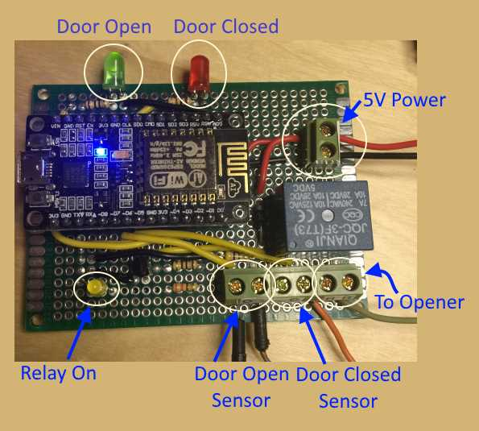
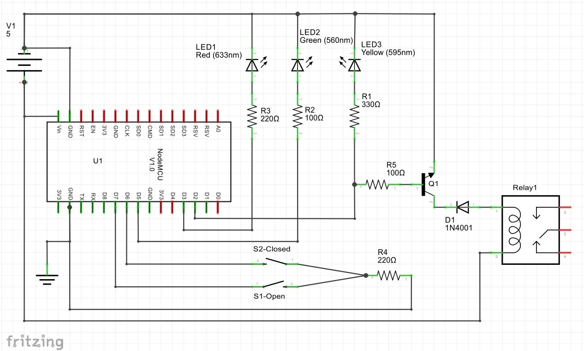
Circuit

Slide 19

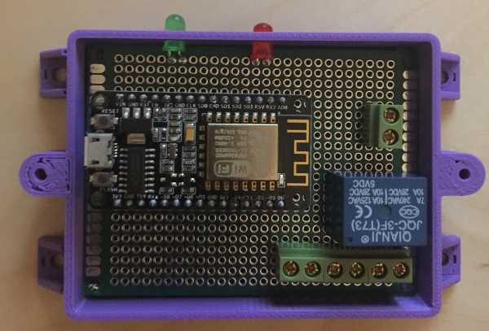
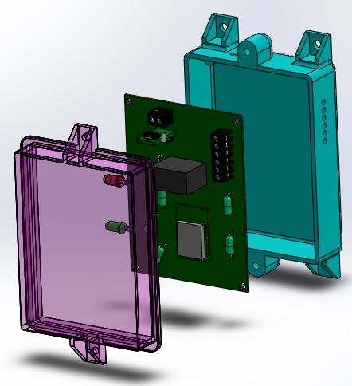
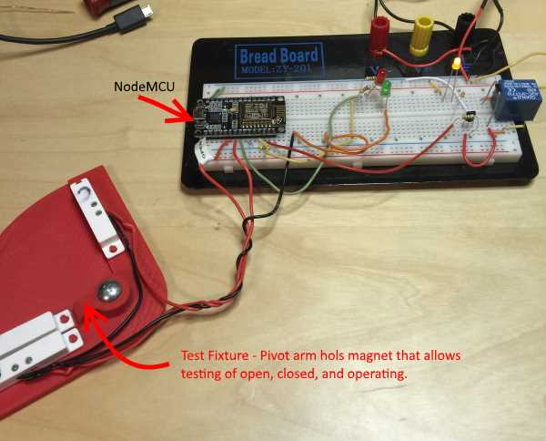
3D CAD Models
Solidworks
Controller Housing
Switch mounting brackets
Bench-test platform
3D Printed w/SLA

